Slide 1
Scala functional programming for collections

Slide 2
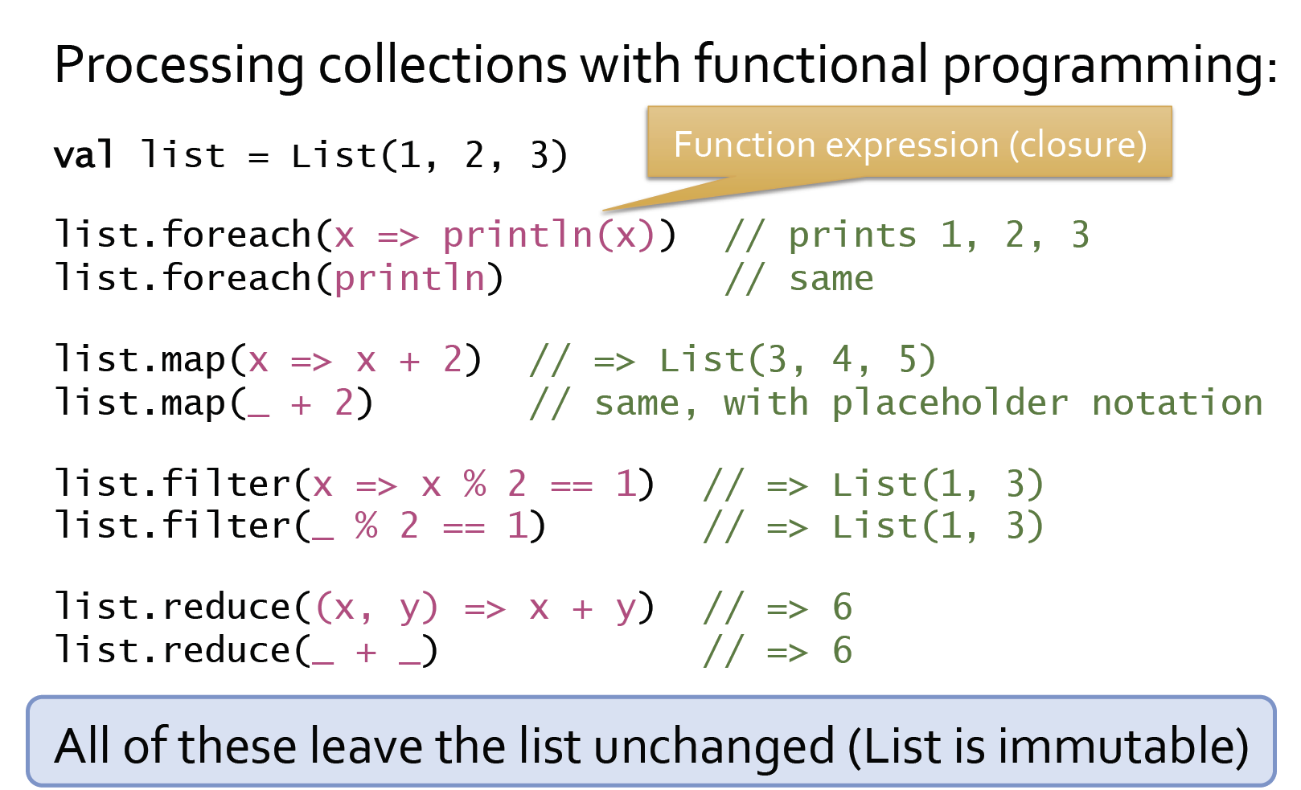
Collections with Functional Programming

Slide 3
How the map function works
List (x = 1, x = 2, x = 3)
Map function
x => x + 2
3 4 5
Transforms each of the input values using the map function

Slide 4
How the Filter Function Works
List (x = 1, x = 2, x = 3)
Filter function
x => x % 2 == 1
true
false
true
1 3
Keeps all the values in the input list evaluates to true on the filter function.

Slide 5
How the Reduce Function Works
List (x = 1, y = 2, y = 3)
Reduce function
(x, y) => x + y
x = 3
(x, y) => x + y
6
Applies the reduce function on every pair of input values.

Slide 6
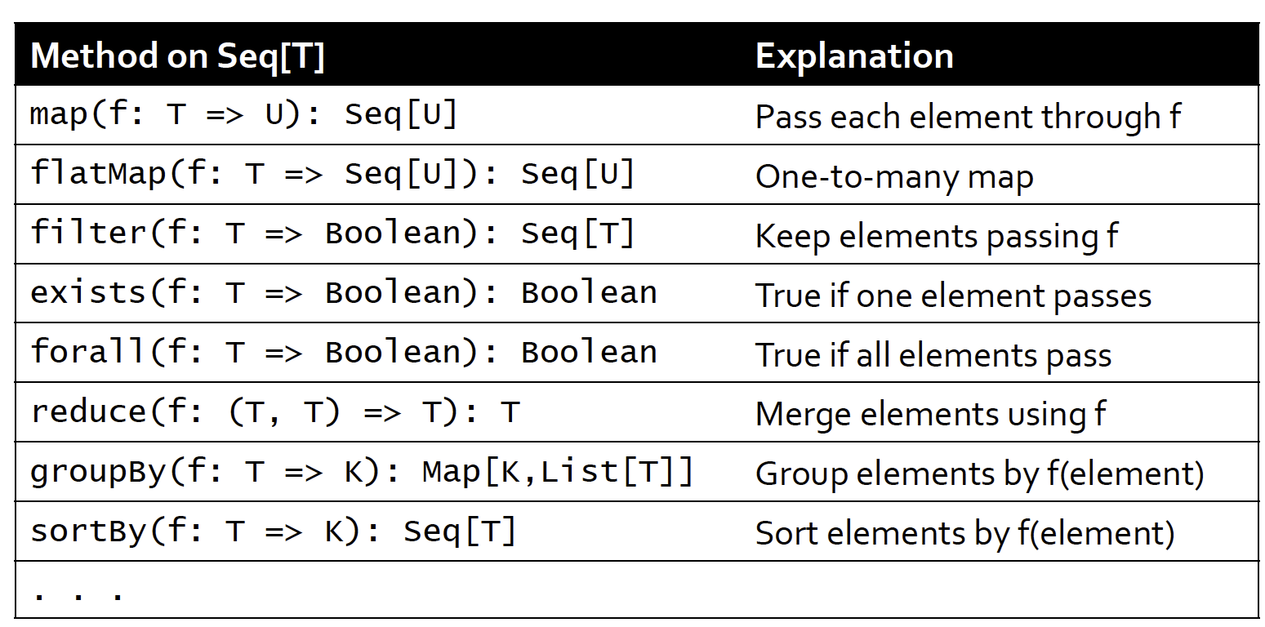
Other Collection Methods
Here are some of the more useful collection methods defined for the sequence class Seq[T].
The Seq[T] class is the base class that all sequential collections are inherited from, include the following: Array, Range, List, Vector, etc.
Therefore all these operations are available for collections such as Array, Range, List, Vector, etc.

